Slide 1
DevOps - Introduction
10-Sep-2018

Slide 2

Noticeable Challenges and Trends
AGENDA
01
Before DevOps
02
What is DevOps
03
DevOps Architecture
04
DevOps Life Cycle
04
05
Q & A
08

Slide 3
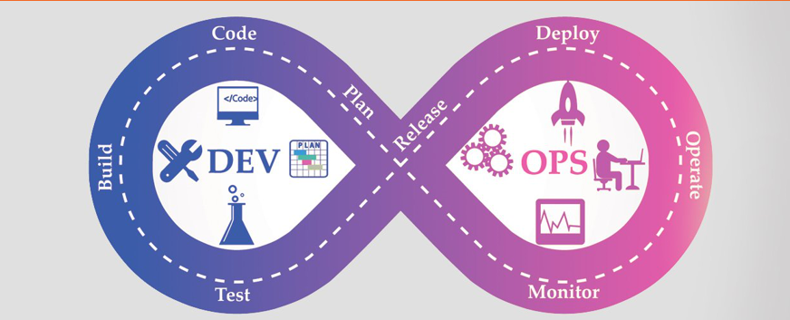
DevOps

Slide 4
Project Execution Methodologies
Traditional Waterfall Model
Requirements are clear and fixed
Product definition is stable
Agile Development Model
Requirements are not fixed and changes frequently
Development Cycles are short
DevOps Approach
Requirements are not fixed and changes frequently
Dev Needs to be Agile
Ops Needs to be Agile

Slide 5
SDLC - Phases
PLANNING – Focus on scope of the project. Output includes project plans,Schedules,Cost estimates etc.
REQUIREMENTS – Gathered from Stake Holders / SME’s. Output includes requirements documents.
DESIGN AND PROTOTYPING – Design Patterns and software architecture frameworks. Output includes Design documents.
SOFTWARE DEVLOPMENT – Models include Waterfall Model / Agile Model. Output includes functional and testable s/w.
TESTING – Unit testing, functional /NFR testing, Regression testing , Performance testing, Security testing etc.
DEPLOYMENT – Manual or Automated deployment practices. Output includes release to production
OPERATIONS AND MAINTENANCE – End of beginning. Different support levels in Organizations.

Slide 6
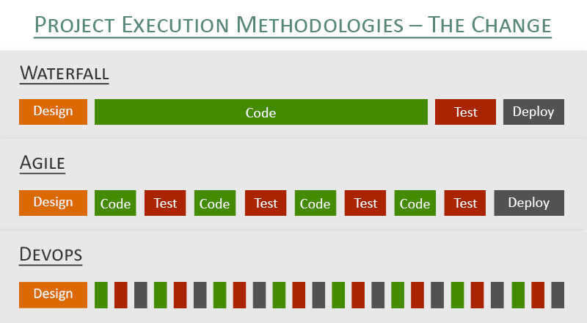
Project Execution Methodologies – The Change

Slide 7
What is DevOps about
DevOps is a Modern software engineering Culture and Practices to develop a software where the development and operation teams work hand in hand as one unit, unlike the traditional ways, i.e., Agile Methodology where they worked individually to develop software or provide required services.
DevOps is the latest trend in software development lifecycle
DevOps is not a goal, but a never-ending process of continual improvement – Jez Humble
The logo of DevOps is the infinity symbol, or better: constant activity. DevOps is about:
Constant development
Constant testing
Constant integration
Constant implementation
Constant monitoring

Slide 8
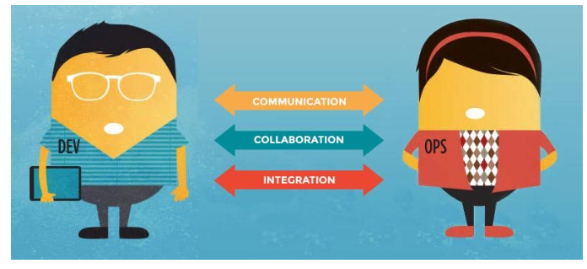
What are the principles of the DevOps approach

Slide 9
Why DevOps Came into Existence
Lack of cultural balance between Development and Operations teams
Operations and development teams working in an isolated environment.
Testing and Deployment activities mostly were performed in an isolated manner after design-build step and they took more time than actual project completion time.
Teams usually spending a large amount of time in deploying, testing, designing, and building the projects
No proper synchronization between different teams

Slide 10
6 principles for developing a DevOps strategy
Adopt a customer-centric mindset, with short feedback loops with real customers and end users
Avoid the waterfall model where each unit works separately, without overseeing the complete picture, and prefer a company where everyone shares the engineering mindset that is required to make great working products.
Organize your teams vertically so that they can be accountable 'from concept to grave'.
Go for all-round profiles, working in autonomous teams, where they can develop personally.
Focus on continuous improvement to optimize speed, costs and the product/service itself.
Automate everything you can, including the infrastructure, by e.g. using next-gen container-based cloud platforms (infrastructure as code).

Slide 11
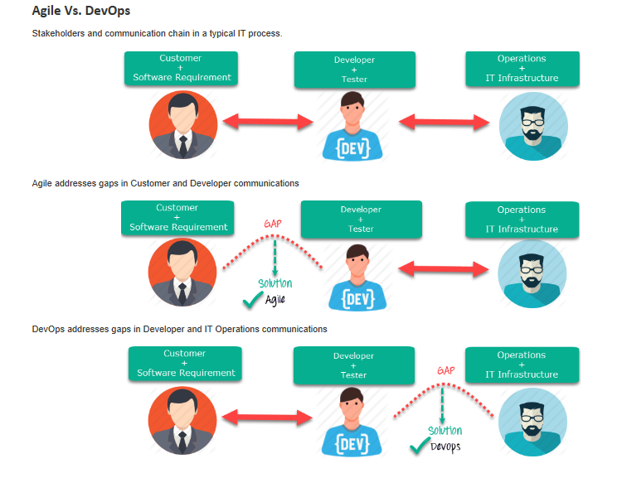
Agile vs DevOps

Slide 12
Agile vs DevOps
Parameter | Agile | DevOps
What is it? | Agile refers to an iterative approach which focuses on collaboration, customer feedback, and small, rapid releases. | DevOps is considered a practice of bringing development and operations teams together.
Purpose | Agile helps to manage complex projects. | DevOps central concept is to manage end-to-end engineering processes.
Task | Agile process focusses on constant changes. | DevOps focuses on constant testing and delivery.
Implementation | Agile method can be implemented within a range of tactical frameworks like a sprint, safe and scrum. | The primary goal of DevOps is to focus on collaboration, so it doesn't have any commonly accepted framework
Team skill set | Agile development emphasizes training all team members to have a wide variety of similar and equal skills. | DevOps divides and spreads the skill set between the development and operation teams.
Team size | Small Team is at the core of Agile. As smaller is the team, the fewer people on it, the faster they can move. | Relatively larger team size as it involves all the stack holders.

Slide 13
Agile vs DevOps
Parameter | Agile | DevOps
Duration | Agile development is managed in units of "sprints." This time is much less than a month for each sprint. | DevOps strives for deadlines and benchmarks with major releases. The ideal goal is to deliver code to production DAILY or every few hours.
Feedback | Feedback is given by the customer. | Feedback comes from the internal team.
Target Areas | Software Development | End-to-end business solution and fast delivery.
Automation | Agile doesn't emphasize on automation. Though it helps. | Automation is the primary goal of DevOps. It works on the principle to maximize efficiency when deploying software.
Goal | It addresses the gap between customer need and development & testing teams. | It addresses the gap between development + testing and Ops.
Focus | It focuses on functional and non-function readiness. | It focuses more on operational and business readiness.

Slide 14
Timeline of Key DevOps Events
1957 – First computer programmers write code using Fortran, creating the first developer jobs
1969 – ARPANET launches, creating the first network engineering jobs and network operations centers
2003 – Ben Treynor is hired to lead a team of seven software engineers to run a production environment at Google, creating the first set of “site reliability engineers”
2009 – John Allspaw and Paul Hammond of Flickr present on “10+ Deploys Per Day: Dev and Ops Cooperation at Flickr,” articulating the methodology of DevOps publicly for the first time
2009 – Patrick Debois organizes the first DevOps Day, in Belgium, and coins the term “DevOps” as a shortened hashtag to promote it
2012 – Splunk and SolarWinds, some of the first DevOps software tools, IPO for $1.57B and $802MM, respectively signaling the growth potential of the industry
2013 – Puppet Labs releases its first State of DevOps survey, highlighting the health and trends of the industry
2017 – The Blue Matador Monitoring Platform launches, combining AI-powered server monitoring and centralized logging under one login

Slide 15
Why DevOps implementation is beneficial
Extend Agile Methodology
Facilitate Communication and Promote Collaboration
Automate Repetitive Tasks
Reduced Failures and Fixes
Speed up Failure Recovery
Build a Performance based work Environment

Slide 16
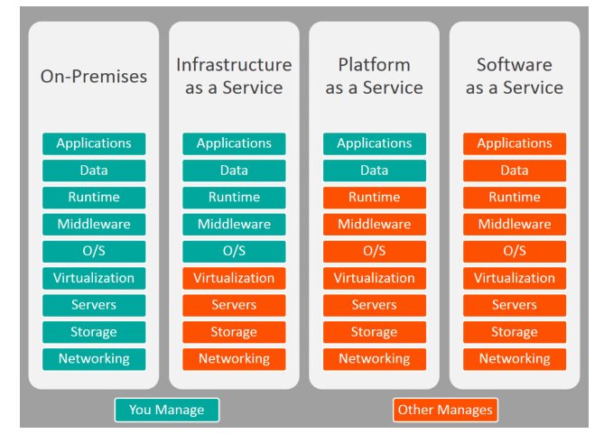
Cloud Computing Service Models

Slide 17
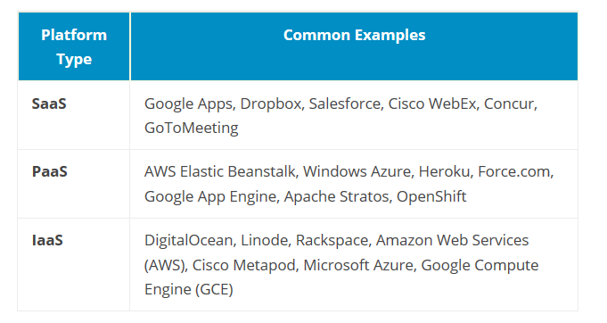
Cloud Computing Service Models

Slide 18
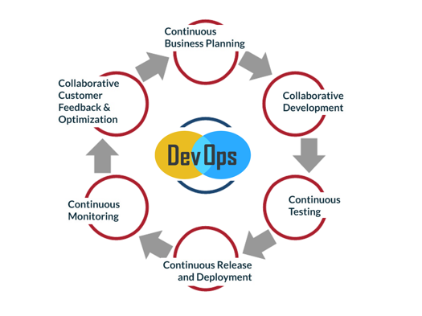
6 C’s OF DEVOPS EVOLUTION

Slide 19
6 C’s OF DEVOPS EVOLUTION
Continuous business planning: Starts with identifying the skills, outcomes, and resources needed.
Collaborative development: Starts with development sketch plan and programming.
Continuous testing: Unit and integration testing to help increase the efficiency and speed of the development.
Continuous release and deployment: Non-stop CD pipeline to help you implement code reviews and developer check-ins easily.
Continuous monitoring: To monitor the changes and address the errors/mistakes spontaneously whenever they happen.
Customer feedback and optimization: This allows the immediate response of your customers for your product and its features and helps you modify accordingly.

Slide 20
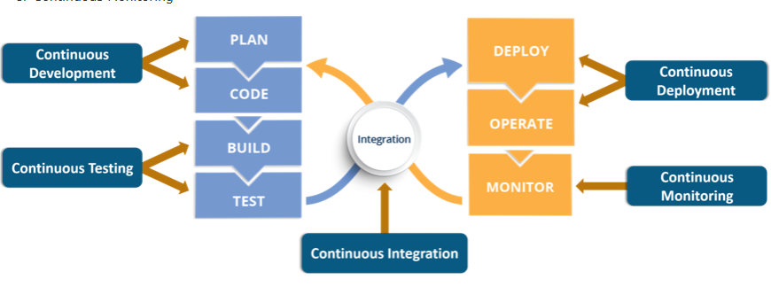
DevOps Lifecycle Phases

Slide 21
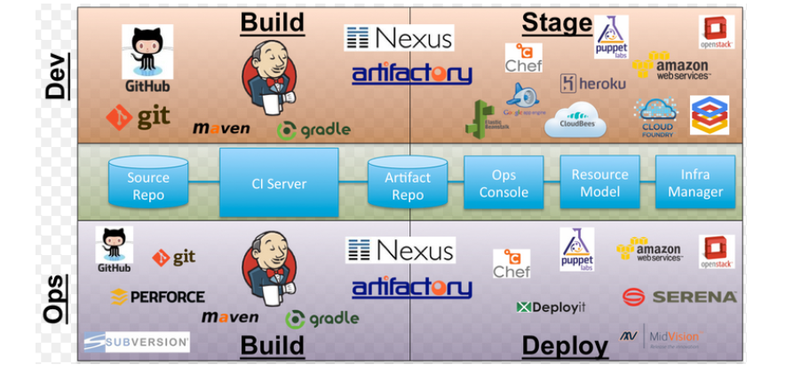
Platform for Continous Delivery

Slide 22
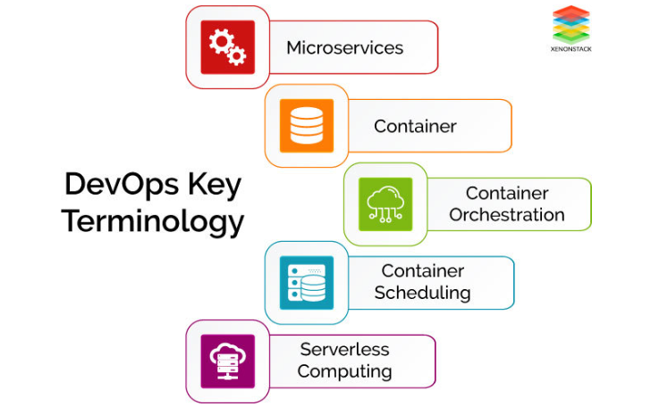
KEY TECHNOLOGIES & TERMINOLOGIES IN DEVOPS

Slide 23
Continous Development
This phase involves ‘planning‘ and ‘coding‘ of the software application’s functionality
Software deliverables are broken down into multiple sprints of short development cycles, developed and then delivered in a very short time.
Involves Coding and Building phases and makes use of tools such as Git and SVN for maintaining the different versions of the code, and tools like Ant, Maven, Gradle for building/ packaging the code into an executable file that can be forwarded to the QAs for testing.

Slide 24
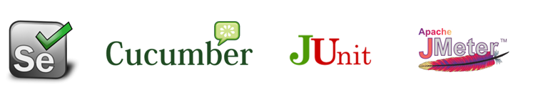
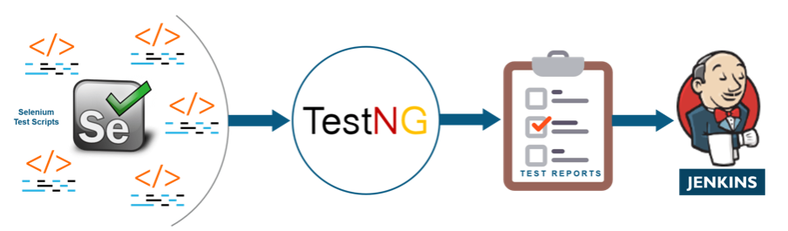
Continous Testing
Continuous Testing is done to obtain immediate feedback on the business risk associated with Software Release. Software rating depends upon Testing.
Automated tools are used for testing as it is easier to do testing continuously instead of testing a whole software. The tool used for testing the software is Selenium.

Slide 25
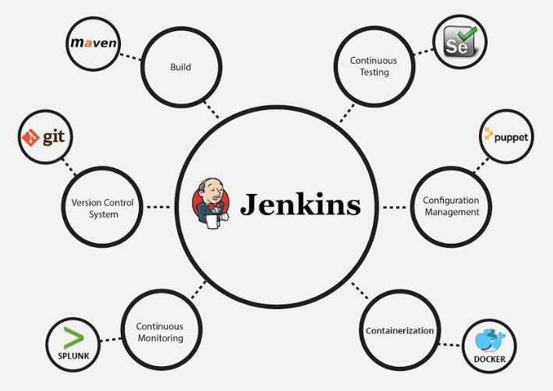
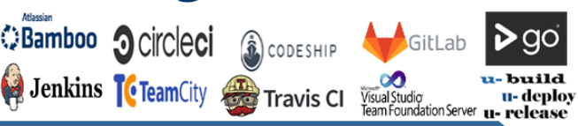
Continous Integration
Continuous Integration (CI) is a software engineering practice in which developers integrate code into a shared repository several times a day in order to obtain rapid feedback of the feasibility of that code. CI enables automated build and testing so that teams can rapidly work on a single project together.
Benefits of CI
Earlier finding & addressing of Bugs
Improve software quality
Reduce the time it takes to validate
Release new software updates

Slide 26
Continous Delivery
Continuous delivery (CD) is a software engineering practice in which teams develop, build, test, and release software in short cycles. It depends on automation at every stage so that cycles can be both quick and reliable.
Continuous delivery is the continual delivery of code to an environment once the developer feels the code is ready to ship – this could be UAT, staging, or production.
Constantly delivering code to a user base, whether it be QA or directly to customers for continual review and inspection.
Although similar to continuous integration, continuous delivery differs because it can feed business logic tests where unit tests are unable to catch all business logic, particularly design issues.

Slide 27
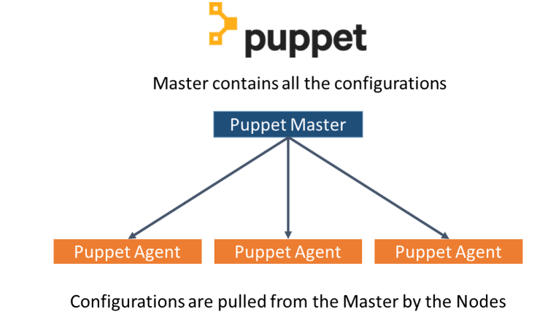
Continous Deployment
Continuous deployment is a strategy for software releases wherein any code commit that passes the automated testing phase is automatically released into the production environment, making changes that are visible to the software's users.
Configuration Management Tools
Releasing deployments to servers, scheduling updates on all servers and most importantly keeping the configurations consistent across all the severs.
Tools like Puppet, Chef, Ansible, SaltStack and more. But the best tool is Puppet. Puppet & the other CM tools work based on the master-slave architecture. When there is a deployment made to the master, the master is responsible for replicating those changes across all the slaves, no matter the number!

Slide 28
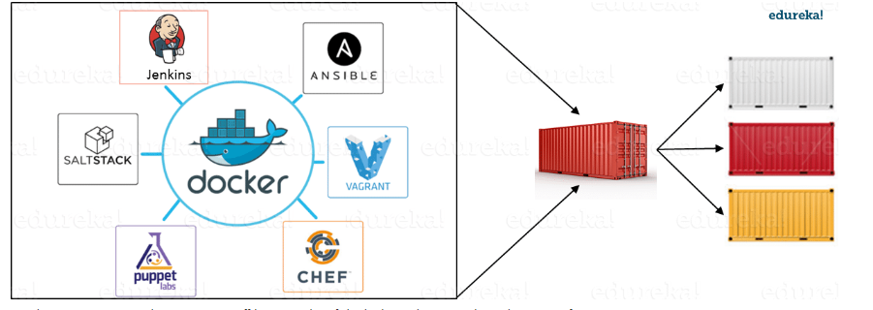
Containerization
Containerization tools are other set of tools which help in maintaining consistency across the environments where the application is developed, tested and deployed. It eliminates any chance of errors/ failure in production environment by packaging and replicating the same dependencies and packages used in development/ testing/ staging environment.

Slide 29
Continous Monitoring
Continuous Monitoring is a reporting tool because of which developers and testers understand the performance and availability of their application, even before it is deployed to operations. Feedback provided by continuous monitoring is essential for lowering cost of errors and change. Nagios tool is used for continuous monitoring.
Some Popular Tools : Splunk, ELK Stack, Nagios, Sensu, NewRelic

Slide 30
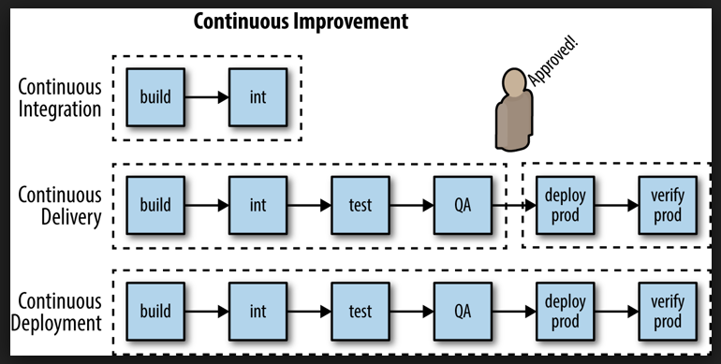
Continous Improvement

Slide 31
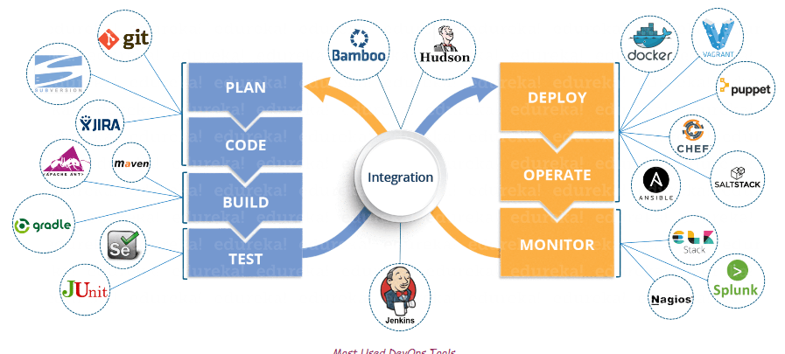
DevOps Tools

Slide 32
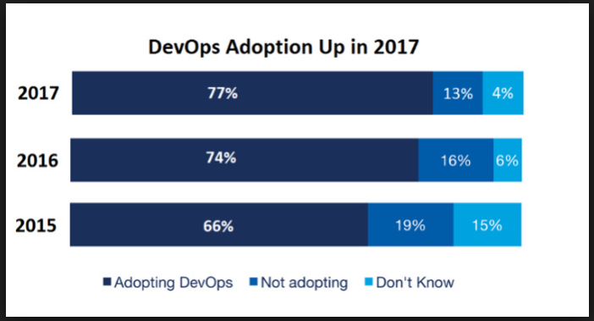
DevOps Adoption Trends

Slide 33

DevOps Implementation at Top Companies/Organisations

Slide 41
References :
https://www.edureka.co/blog/devops-tools

Slide 42


Slide 43
$7 BILLION | 110,000 EMPLOYEES | 31 COUNTRIES

